Slide 1
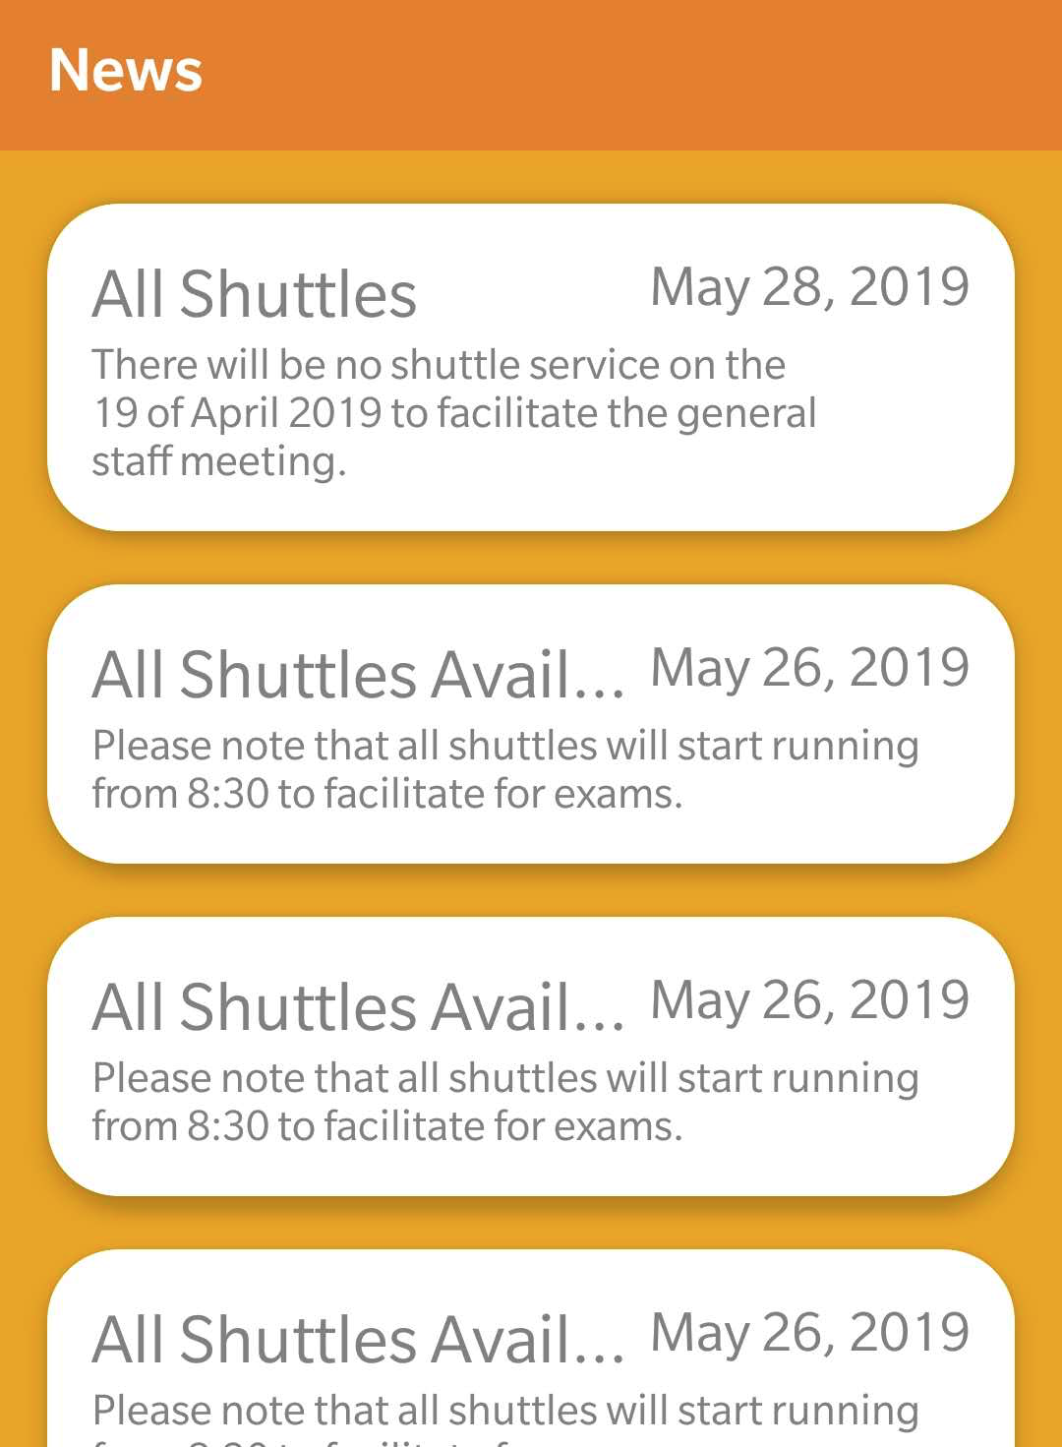
UWI Shuttle
Service Android
Application
By NIRO Solutions

Slide 2
Outline
The Problem
The Bus Application
The Student Application
What’s Next?
Questions

Slide 3
The Problem

Slide 4
What is the
Problem
The Current UWI Cave Hill Bus Service is Inefficient.
The process of verifying a student before they get onto the shuttle is very tedious, time consuming and inefficient.
The driver has to look at all of the student ID cards and verify them by checking their photo and official registration stamp for the current year.

Slide 5
What students do currently
They complain, wait, wait, wait then wait some more until the bus appears.
Students are forced to seek other means of transportation. So the are basically paying double for one service.
Admin keeps a physical log of data but what really happens to this data besides storage? Nothing

Slide 6

Android Student Application
News Updates
Shuttle Card
Shuttle Stand
Settings
Push Notification

Slide 7
News Updates
01
Ordered Data by Date
Instant Changes
Caching for Speed & No Internet

Slide 8
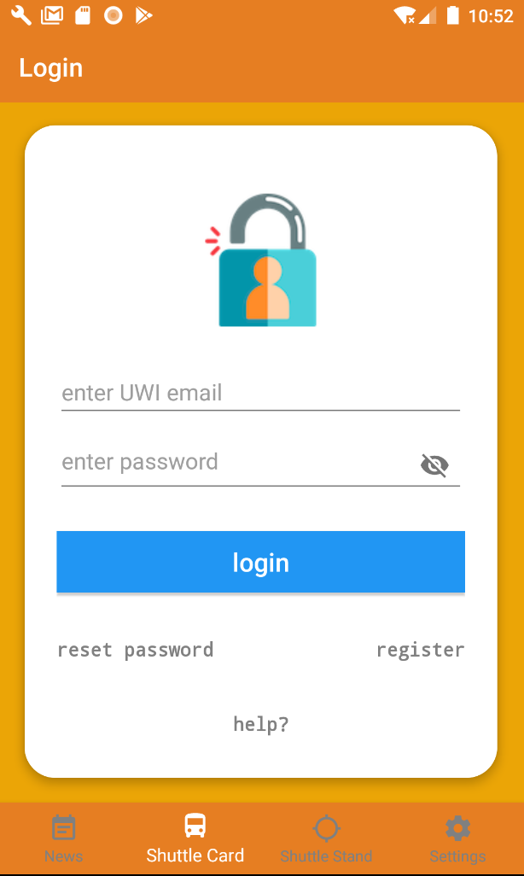
Shuttle Card
02
Authentication by Firebase
User Verification
Email Validation
Help

Slide 9
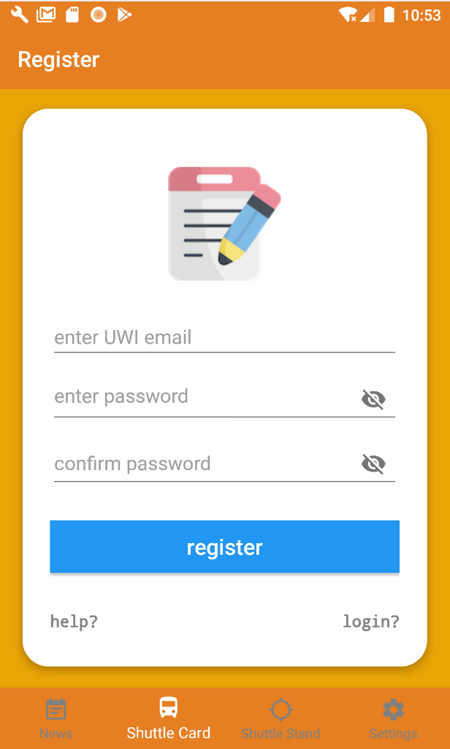
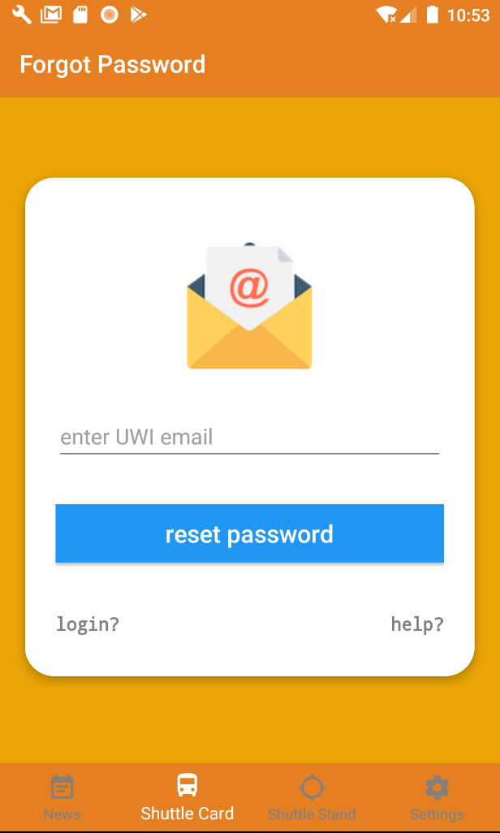
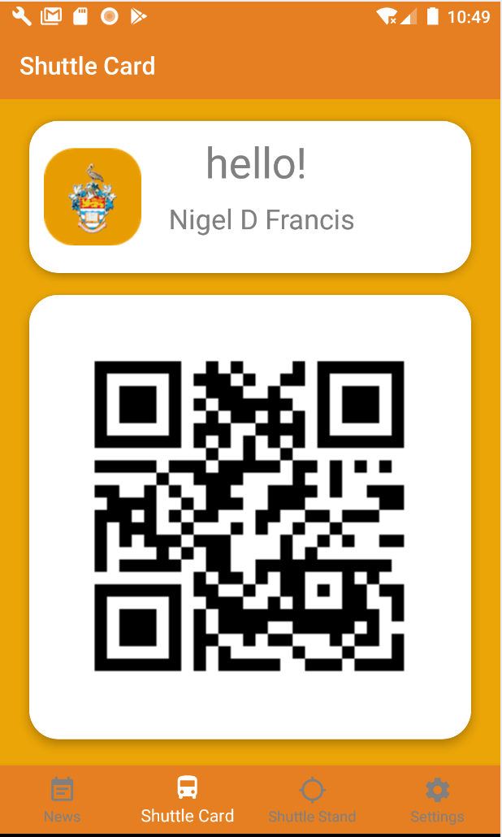
Other Application Features

Slide 10
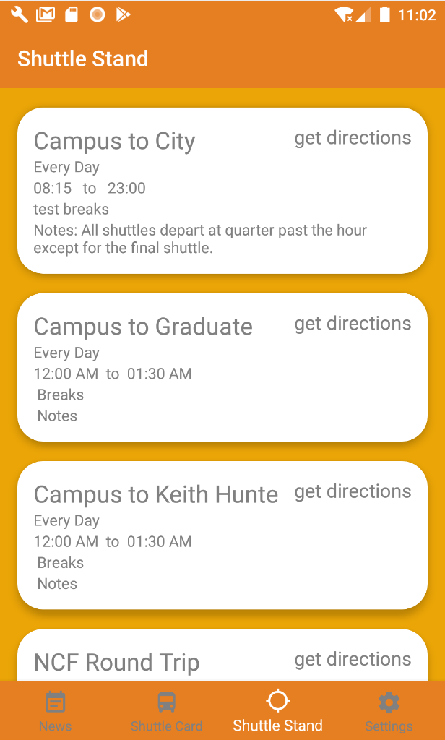
Shuttle Stand
03
Shuttle Schedule
Notes
Maps ( Amaps, Google Maps, Baidu )

Slide 11
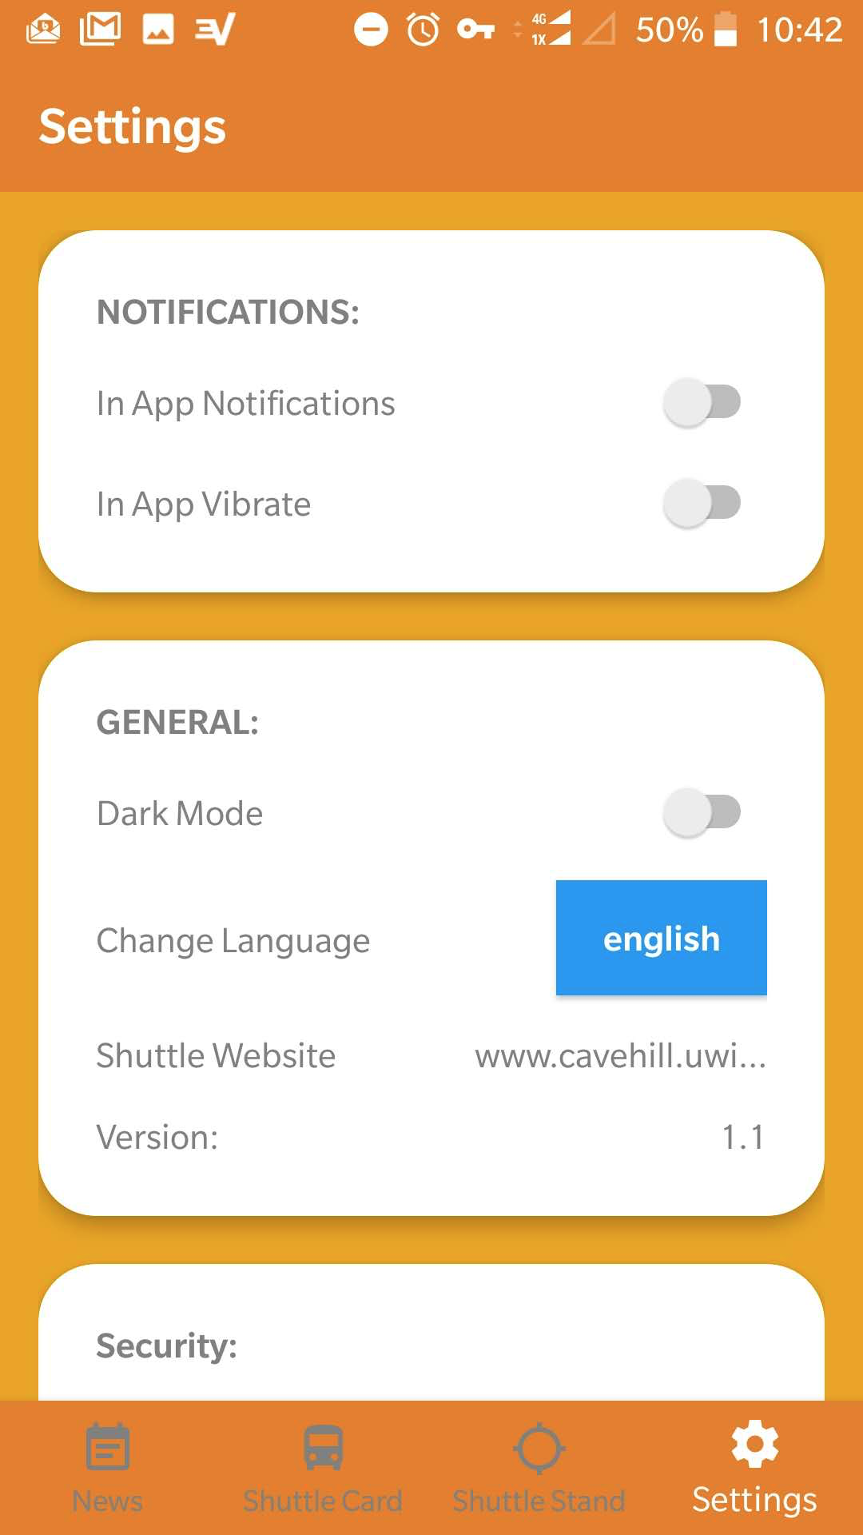
Settings
04
In App notifications
Dark Mode
Language Options
Screen Lock
Biometrics

Slide 12
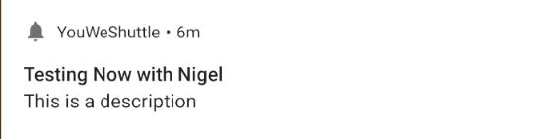
Push Notifications
05
One Signal & Firebase Cloud Messaging
Custom Notification Icon
Notifications in Foreground

Slide 13
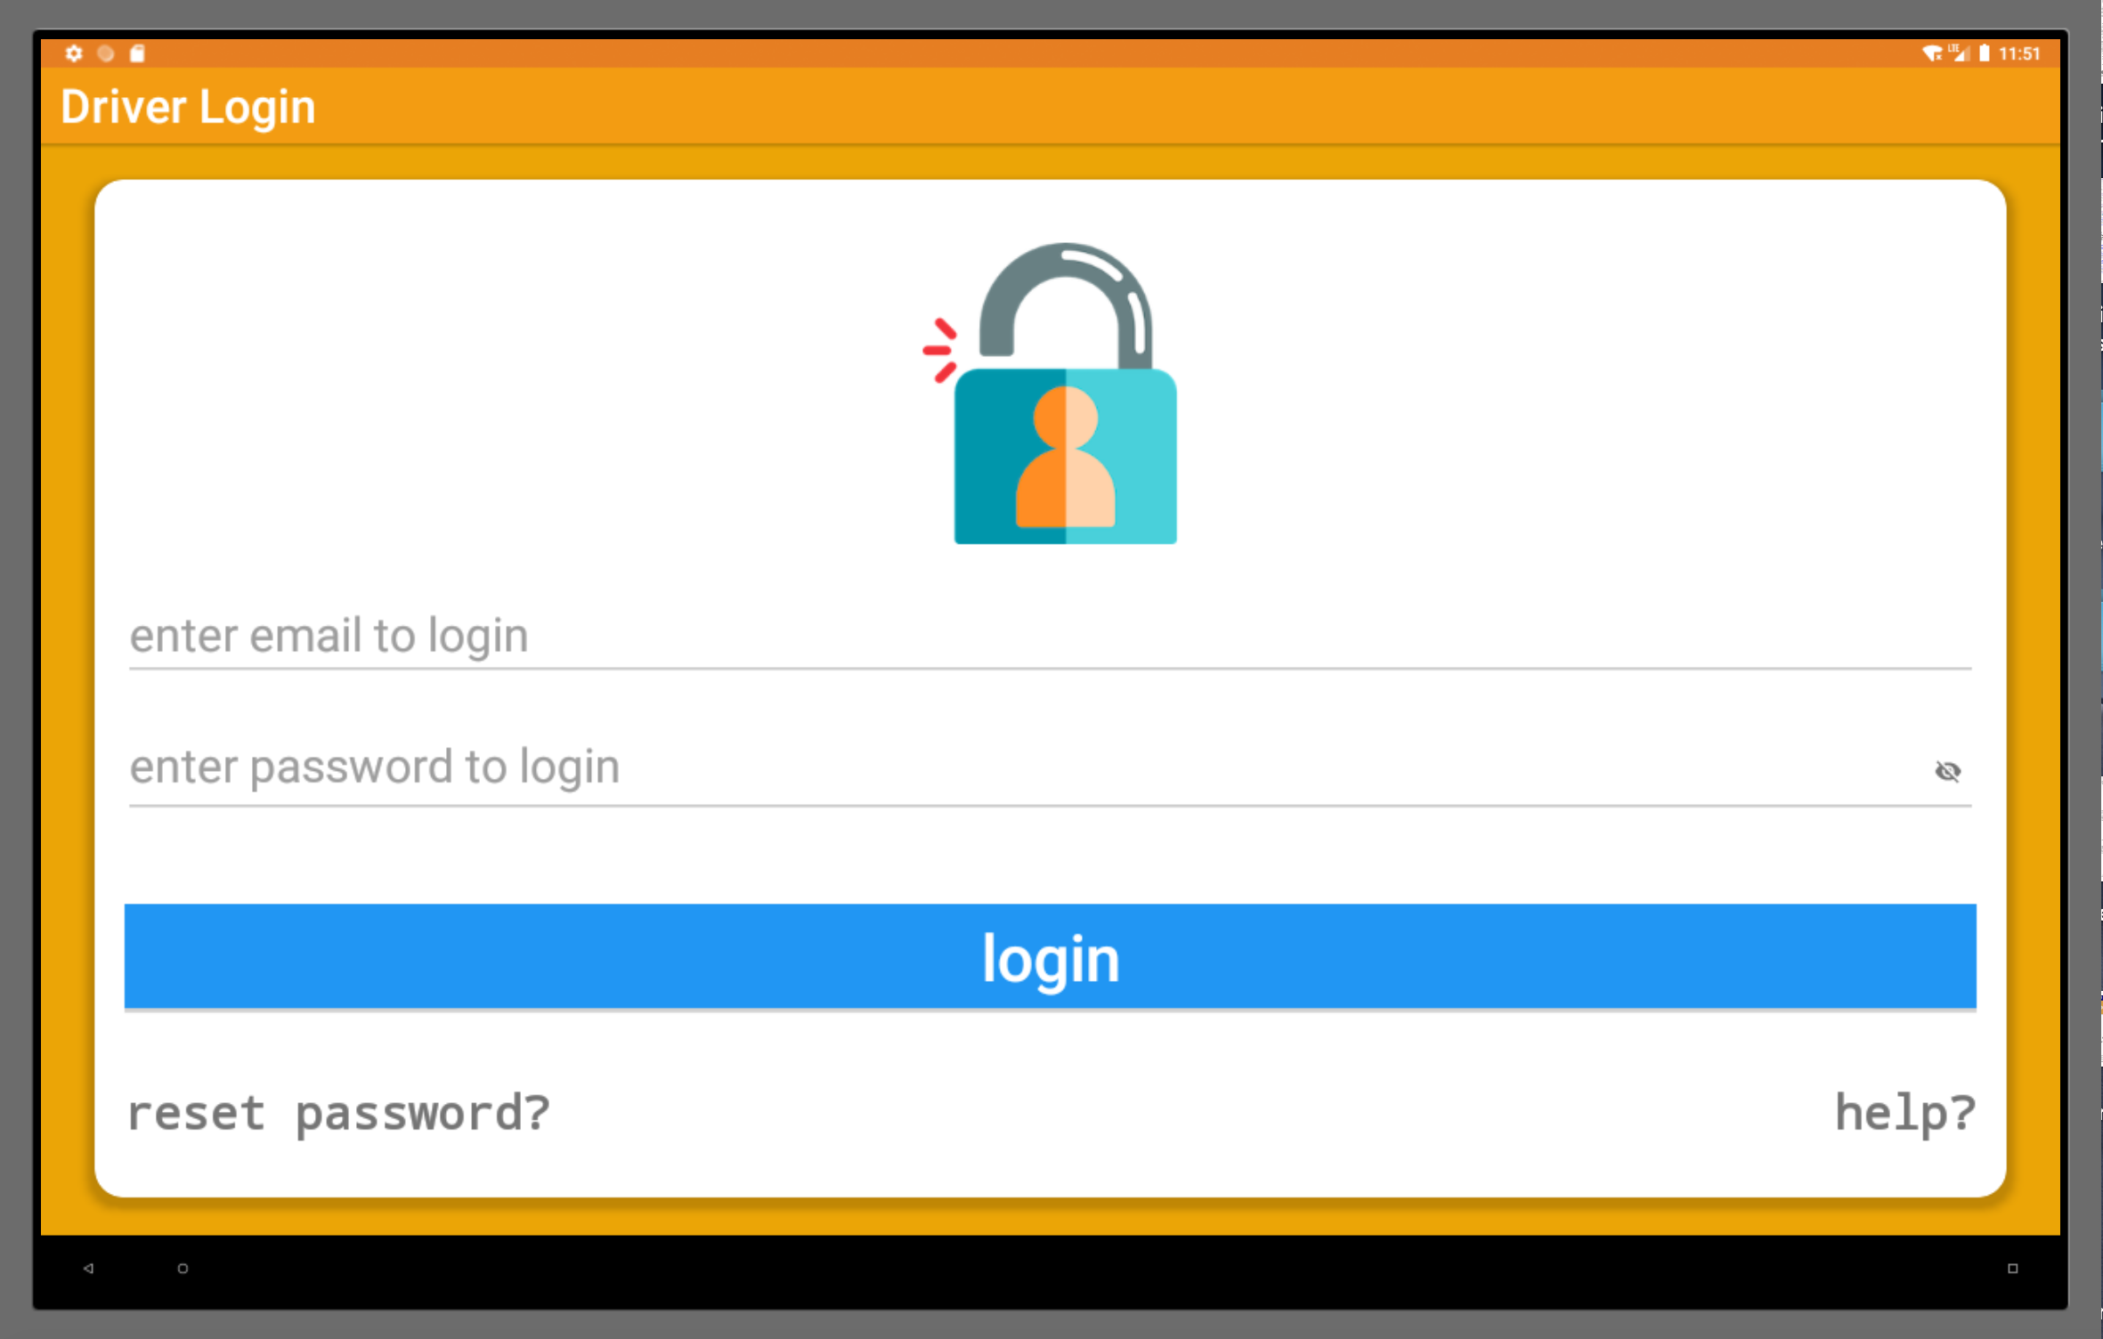
Android Bus Application
Driver Login
Toast & Snackbar

Slide 14
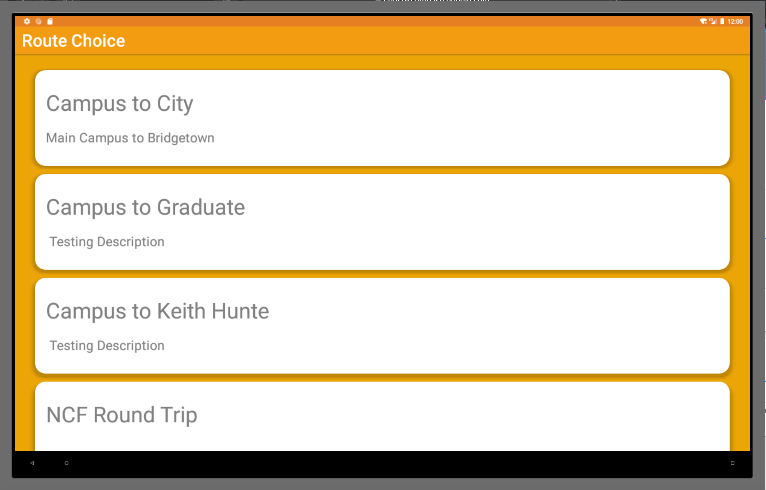
Route Selection
Specific Click Points

Slide 15
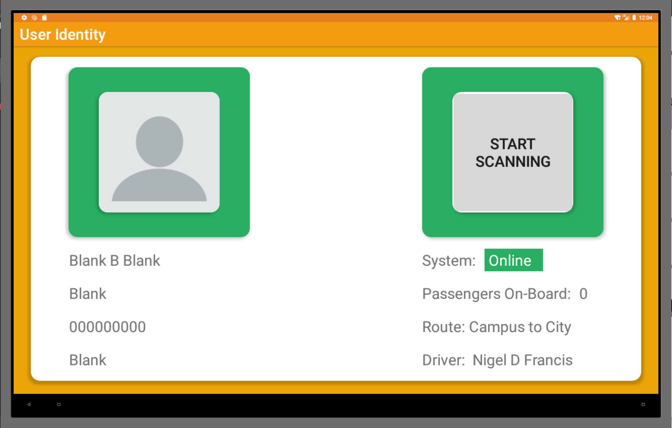
User Identity
FB Snapshots
Setting up Trip log shell
Offline / Online Availability
View Passengers Count
Security / Arrears Check

Slide 16
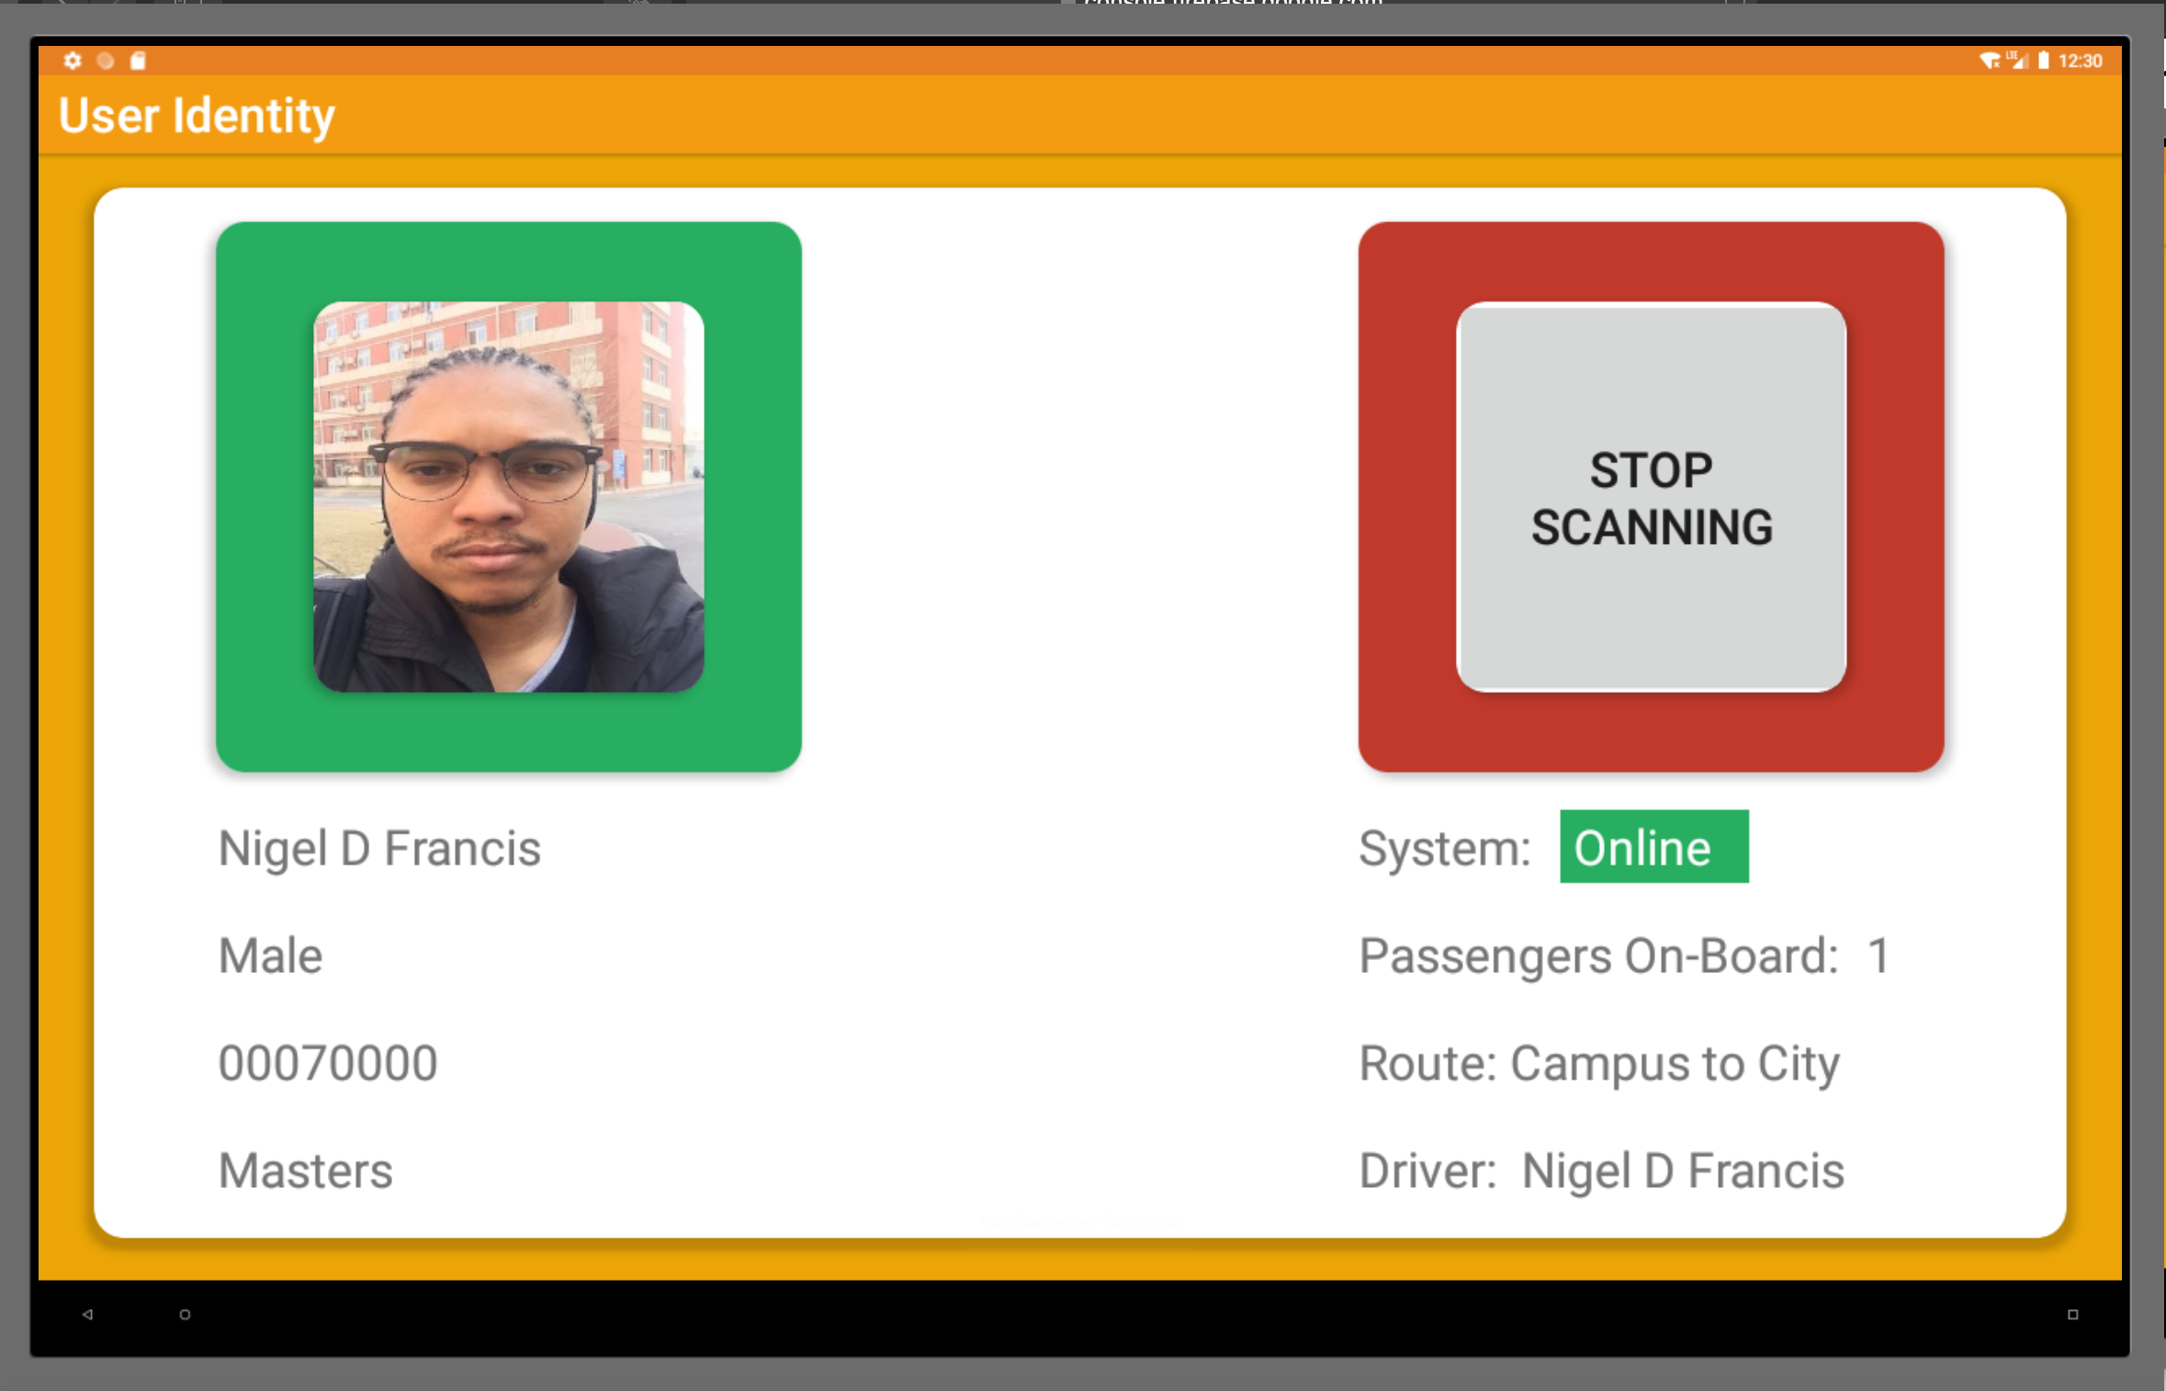
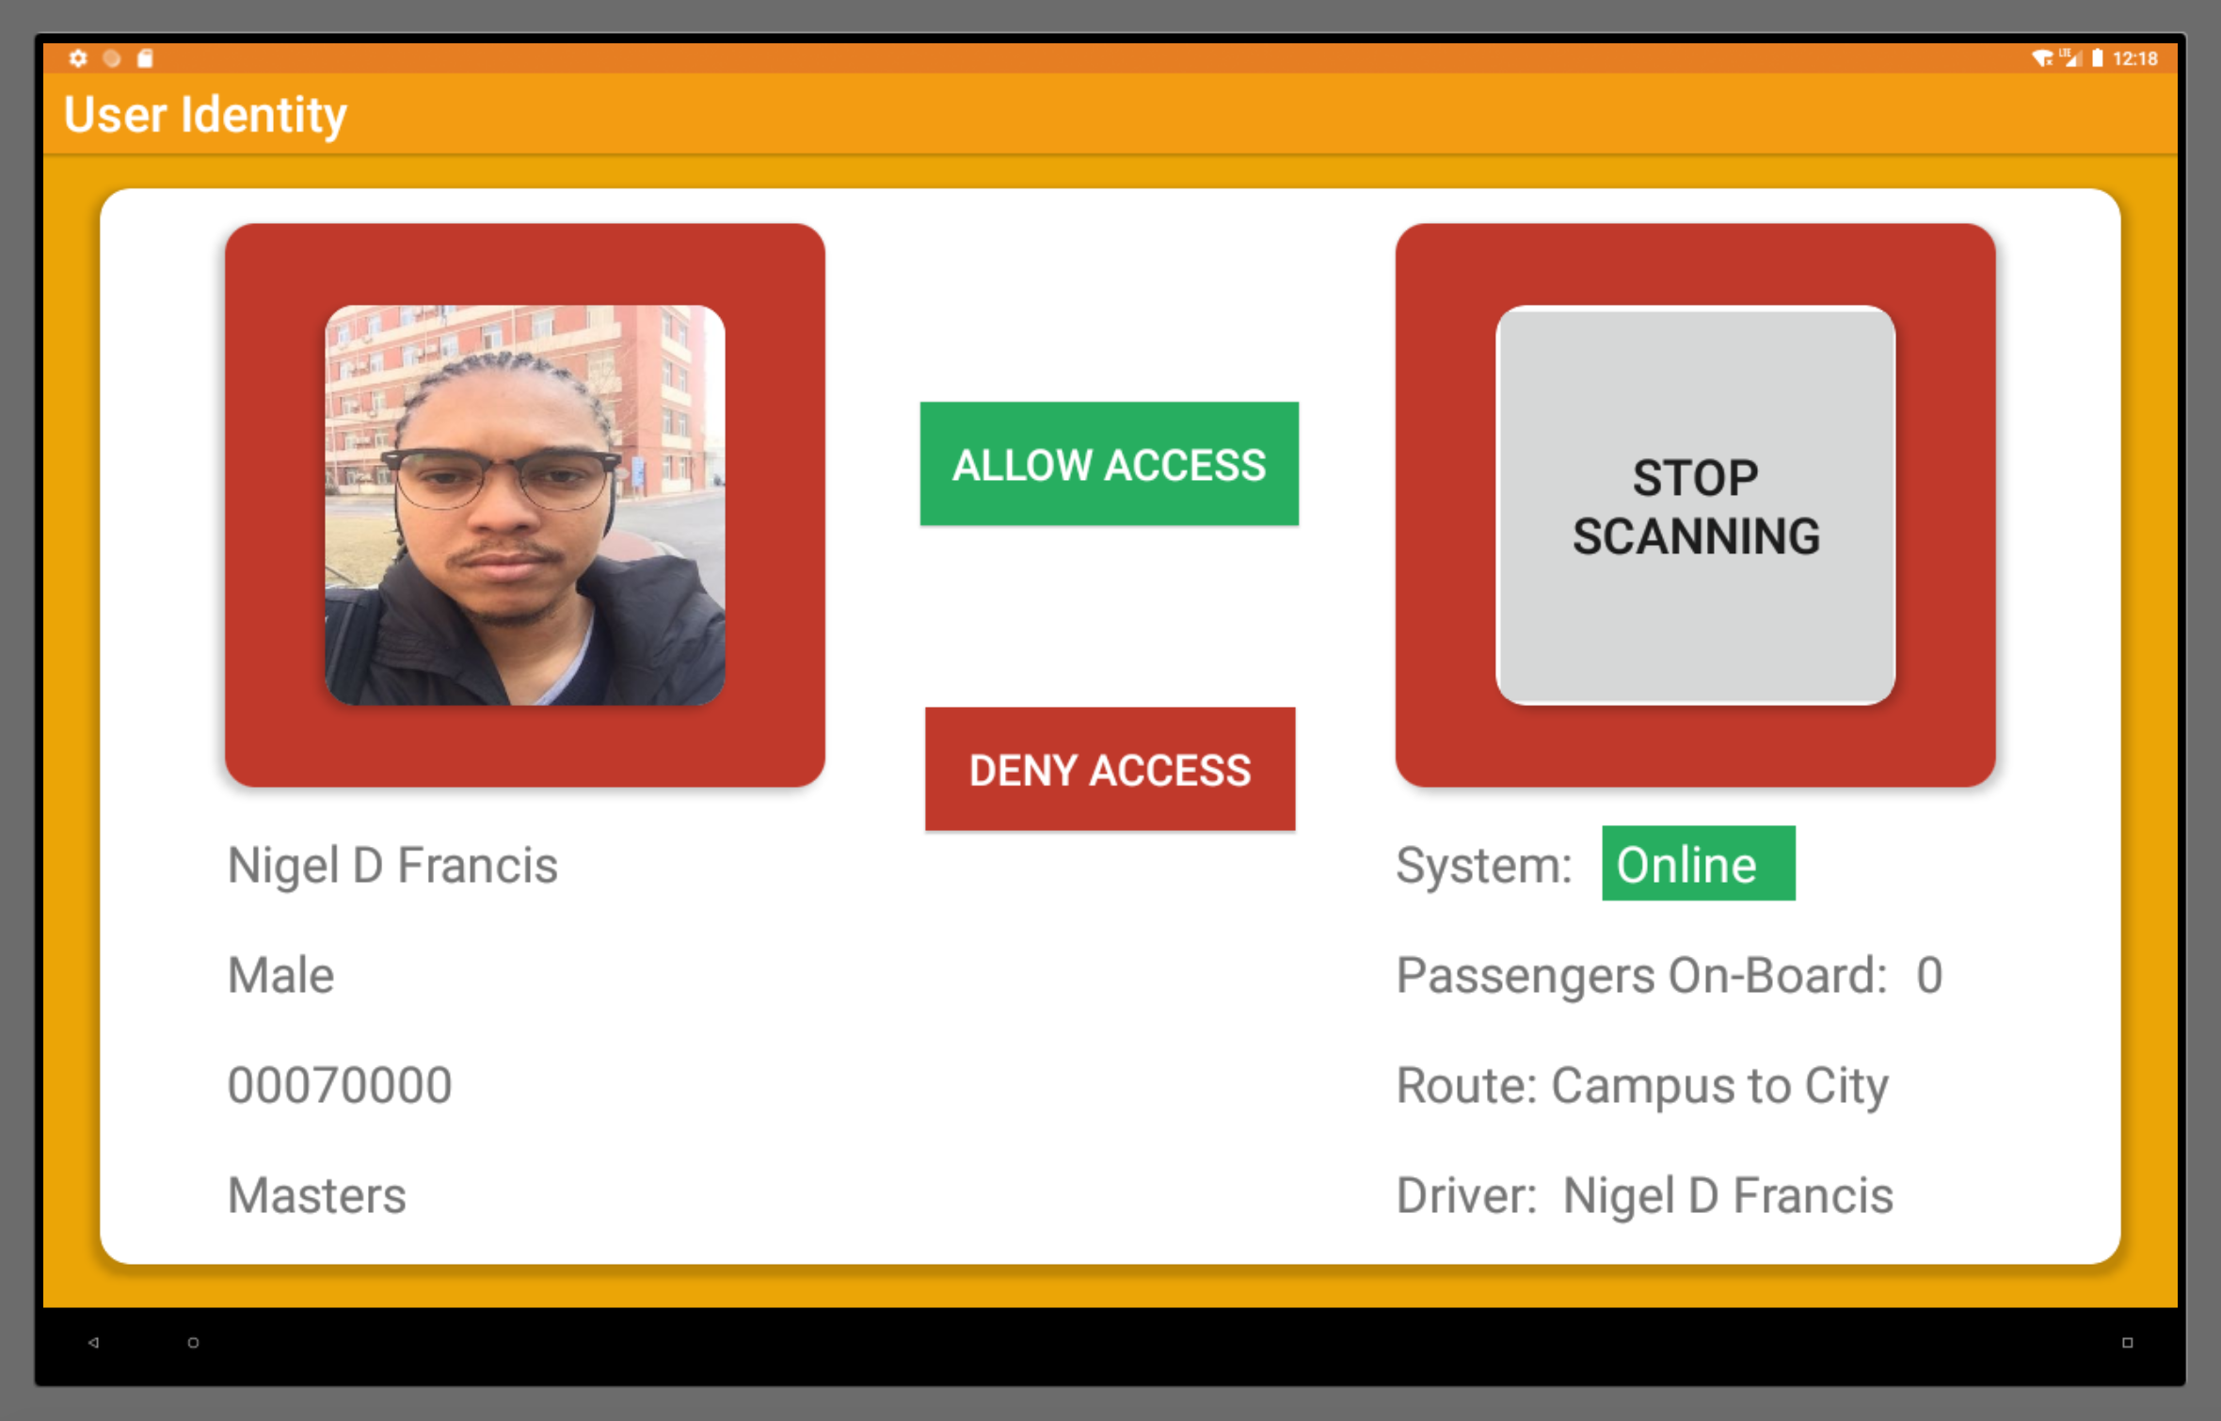
Student Scanning

Slide 17
Next Steps

Slide 18
Application Demonstration
How the NIRO Bus Driver Application and the Student Application work together.

Slide 19
What next?
More Themes & Notification Tones
iOS Development
Website Version for News & Shuttle Stand with Social Media Integration
Maps for Routes
NCF Cards Acceptance
Facial Recognition
Recording a Journey ( Camera )

Slide 20
Questions?

